Slide 1


REVIEW BY THE CEO
Annual General Meeting, 4 April 2018

Slide 2
F-SECURE’s Transformation
CONTINUES
ACCELERATE GROWTH
Special focus on Enterprise-Grade cyber security for mid-market
NEW STRATEGY
Shifting investments towards corporate cyber security
FOUNDATION
World class endpoint protection with special focus in operator channel and consumers
2018-
2015-2017
-2015
4
1
2
3

Slide 3
Megatrends
GEOPOLITICS
REGULATION
CLOUDIFICATION
Increasing demand
for cyber security products
and services
CYBER ATTACKS
DIGITALIZATION
Evolving threat landscape
No 100% protection
More data sources
Automation and AI
Visibility
Increasing complexity
Lack of trained personnel
Cost of expertise
NEED FOR DETECTION
AND RESPONSE
NEED FOR BETTER
SECURITY ORCHESTRATION
NEED FOR
OUTSOURCING

Slide 4
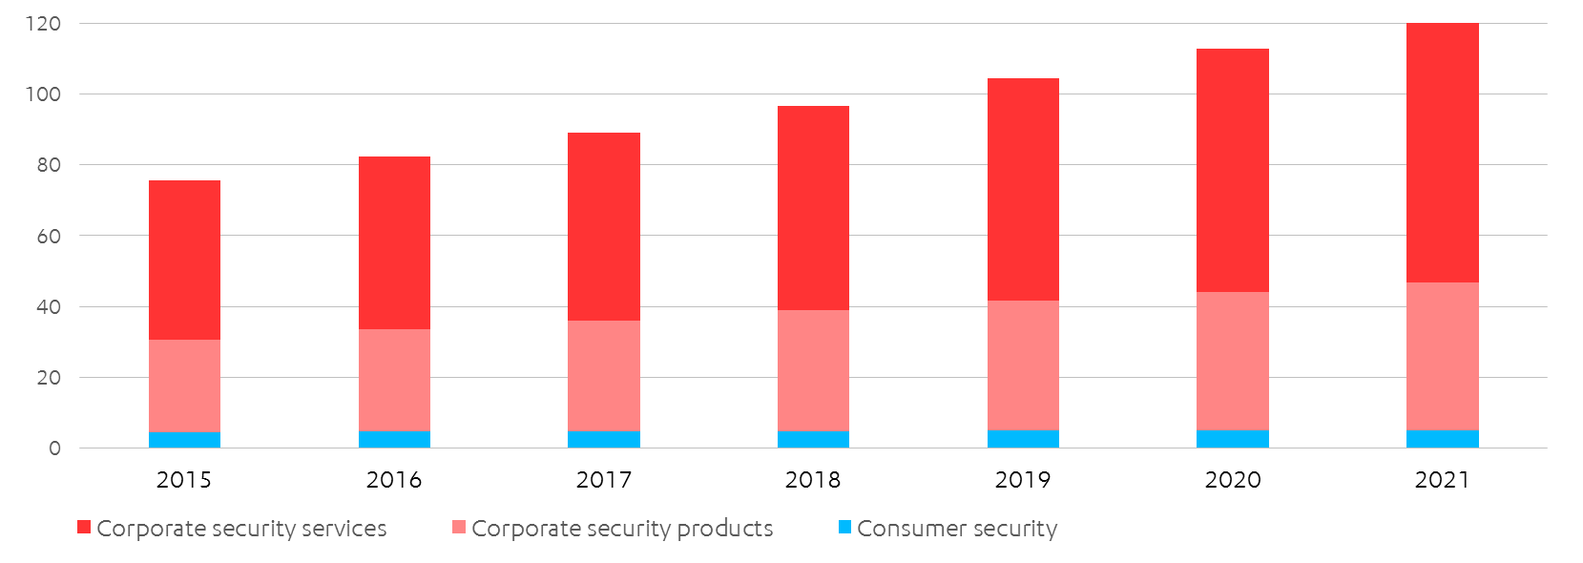
CORPORATE SECURITY CONTINUES
TO DRIVE THE GROWTH
INFORMATION SECURITY REVENUE FORECAST 2015-2021
USD billion
+8.9% annually
+7.7% annually
+1.7% annually
Source: Gartner, Feb 2018

Slide 5
DIFFERENCES BETWEEN SEGMENTS
ENDPOINT PROTECTION
ENDPOINT DETECTION & RESPONSE
VULNERABILTY MANAGEMENT
CYBER SECURITY SERVICES
CONSUMER
SECURITY
“Mature”
“Emerging”
“Fast growth”
“Fast growth”
“Mature”
3,5
BILLION
0,4
BILLION
1,0
BILLION
16,0
BILLION
4,6
BILLION
CAGR 2015-21
2.4%
CAGR 2015-20
45.3%
CAGR 2015-20
13.0%
CAGR 2015-20
10.0%
CAGR 2015-21
1.3%
Source:
Gartner
Source:
Gartner
Source:
IDC
Source: Markets&Markets
Source:
Gartner

Slide 6
F-SECURE’S strategic focus

Slide 7
EXPANSION OF F-SECURE’s OFFERING
ENDPOINT
PROTECTION ONLY
COMPREHENSIVE CYBER SECURITY OFFERING
INTEGRATED SECURITY
SUITE
F-Secure Radar
Endpoint protection
Cyber security services
Rapid Detection Service
– 2015
2015–2017
2018 –

Slide 8
Enterprise-Grade cyber security for the mid-market
MID-MARKET
LARGE ENTERPRISES
SMALL BUSINESS
SHARED SECURITY TECHNOLOGY
CONSUMERS
Privacy
Family
Connected home
But that’s not all!
All of which are great opportunities, as we have an excellent channel (operators) to reach them
And finally we can also monetize (some of) the solutions in the consumer market – where there are also additional upsides with our good offering

Slide 9
MID-MARKET HAS BROADER NEEDS &
MORE CAPACITY TO SPEND
Company size
Available budget*
Customer focus
1k–10k
Endpoint protection
SMALL COMPANIES
25–200
seats
100k–1M
Best of Suite
MID-MARKET
200–5000
seats
1M–5M
Best of Breed
ENTERPRISES
+5000
seats
* SOURCE: SANS institute

Slide 10
BROADER OFFERING EXPANDS
BUSINESS OPPORTUNITIES
Sales
CYBER SECURITY SERVICES
ADDITIONAL SOLUTIONS
INITIAL SOLUTION
Time

Slide 11
DETECTION CAPABILITIES OFFER
TWO FAST GROWTH MARKETS
100%
100%
100%
100%
35%
15%
10%
1%
2017
2020
2016
2020
Sources: "Forecast Snapshot: EDR" 3/2017, "Market Guide for MDR Services" 5/2017, Gartner
SHARE OF ENDPOINTS
WITH AUTOMATED DETECTION CAPABILITIES
SHARE OF COMPANIES
WITH DETECTION
AS A SERVICE

Slide 12
BRINGING TOGETHER ENDPOINT PROTECTION
AND DETECTION & RESPONSE
2018
World-class
endpoint protection
F-Secure Rapid
Detection Service
Endpoint detection & response

Slide 13
cOMBINATION OF MaN & MACHINE
OFFERS UNIQUE COMPETITIVE ADVANTAGE
CYBER SECURITY
EXPERTS
ARTIFICIAL
INTELLIGENCE
SECURITY
TECHNOLOGY

Slide 14
SCALABILITY THOUGH
A GLOBAL NETWORK OF PARTNERS
CORPORATE SECURITY
PRODUCTS & SERVICES
CONSUMER SECURITY
PRODUCTS
RESELLERS
6000+
CYBER SECURITY SERVICES
OPERATORS
200+ globally
RETAIL & ETAIL
100,000+ COMPANIES
HUNDREDS OF LARGE ENTERPRISES
TENS OF MILLIONS OF CONSUMERS

Slide 15
CONSUMERS’ SECURITY NEEDS
ARE GETTING BROADER
PRIVACY
FAMILY
DEVICES
CONNECTED HOME
Worry about
viruses and ransomware
Concerned about
online and WiFi privacy
Protecting kids from inappropriate content
is important
IoT Gadgets in Use
by 2020
88%
73%
91%
>20B

Slide 16











F-SECURE HAs A COMPETITIVE PORTFOLIO
F-SECURE SAFE (with KEY)
F-SECURE FREEDOME
F-SECURE SENSE
Award winning technology
Built to fit operator channel business model
Simplicity leads to market leading NPS
Consistently in the Top 3 recommended VPN apps
Ease of use that re-defined VPN category user experience
Browsing and tracking protection
Superior set-up experience
Automated software upgrades
Certified and globally available
Operator channel track record
KEY
DIFFERENTIATION
EXAMPLE
COMPETITORS
Further differentiation through market leading NPS and seamless portfolio experience

Slide 17
SYNERGIES ACROSS SEGMENTS
MID-MARKET
LARGE ENTERPRISES
SMALL BUSINESS
SHARED SECURITY TECHNOLOGY
CONSUMERS
Privacy
Family
Connected home
But that’s not all!
All of which are great opportunities, as we have an excellent channel (operators) to reach them
And finally we can also monetize (some of) the solutions in the consumer market – where there are also additional upsides with our good offering

Slide 18
F-Secure
Growth drivers
Wider and better integrated portfolio addressing fast growth segments in corporate security
Solid performance with healthy profitability in consumer security
Increase in share of wallet by cross-selling and upselling
Active M&A

Slide 19
F-SECURE’S
BUSINESS
PERFORMANCE in 2017
Continuing operations only

Slide 20

IMPORTANT NUMBERS FROM 2017
Total revenue growth
Corporate security revenue growth
Consumer security revenue growth
+7%
+16%
+1%
EBIT as % of revenue
Net addition in staff
7%
+78

Slide 21

DEFERRED REVENUE
GROWS FASTER THAN REVENUE
Growth yOy, %

Slide 22
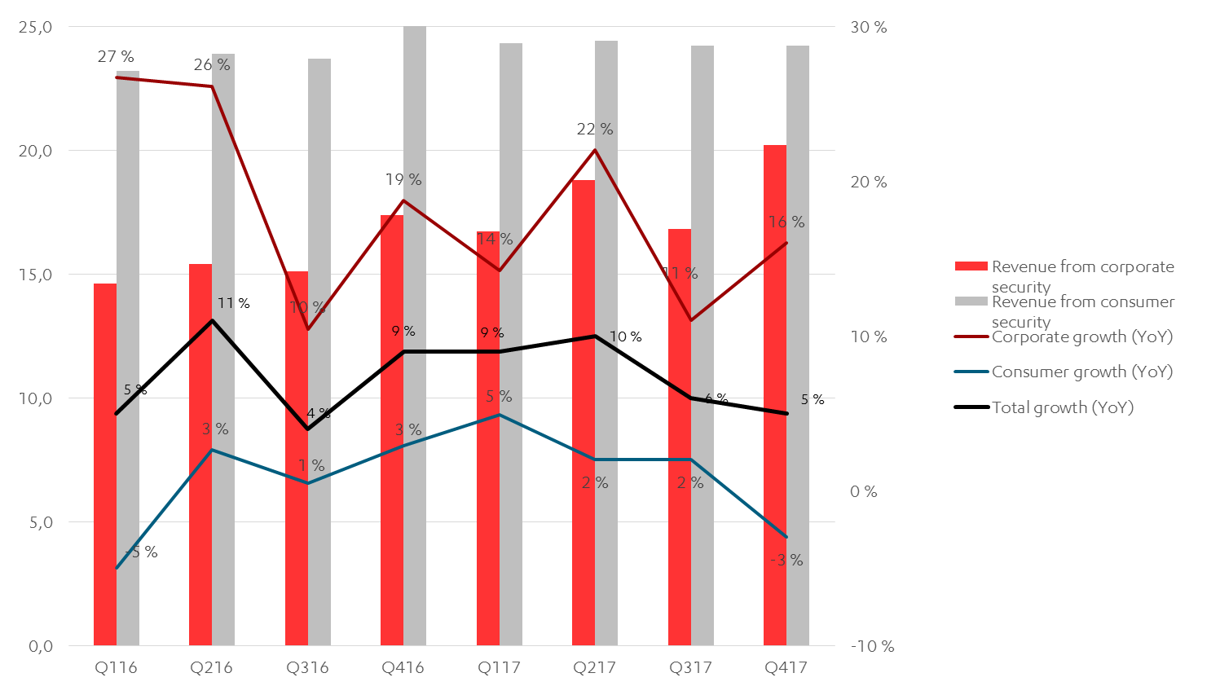
CORPORATE SECURITY CONTINUES
TO DRIVE GROWTH DESPITE SEASONALITY
EUR m
Growth %
nSense acquisition
impact

Slide 23
IMPORTANT STEPS TAKEN IN
CORPORATE SECURITY in 2017
STRONG GROWTH WITH NEW PRODUCTS
STRONG GROWTH IN CYBER SECURITY SERVICES
SOLID GROWTH WITH ENDPOINT PROTECTION BUSINESS
SUCCESSFUL
RECRUITMENT IN R&D, SALES & MARKETING
Sales expansion of Rapid Detection Service and
F-Secure Radar, sales in 20 countries
Strong demand, increased deal sizes and repetitive deals
Continued slightly above market growth in endpoint protection, best-in-class security technology
Attractive employer brand, net addition of 78 employees in 2017
2017

Slide 24
SOLID PROGRESS IN CONSUMER SECURITY
STRONG GROWTH IN DIRECT SALES
CONSUMERS INCREASINGLY BUYING BOTH SECURITY & PRIVACY
OPERATOR CHANNEL REMAINS STABLE
SENSE AS SOFTWARE
AN EMERGING OPPORTUNITY
Increased upselling and strong growth with TOTAL, FREEDOME also in good growth
Upselling and cross selling to Freedome and SAFE customers
Revenue at previous year’s level, high NPS scores,
Operators interested in the security for connected homes
2017

Slide 25
SOLID CASH FLOW & DIVIDENDS
EUR million
% of revenue
94,3
92,7
90,2
61,3
2015:
Sale of younited
Acquisition of
nSense
Dividend policy
* Proposed dividend
** Including continuing and discontinued operations

Slide 26
OUTLOOK FOR 2018
F-Secure continues to invest in the growth of the corporate business, both the development of cyber security products and services as well as sales and marketing of these solutions.
Revenue from corporate security is expected to grow by over 15% compared to 2017
Revenue from consumer security to stay at the same level as in 2017.
EBIT is expected to be in the range of 8-12M€

Slide 27
OUTLOOK FOR 2018-2021
The demand for corporate cyber security products and services is expected to grow strongly. F-Secure aims to grow faster than the market, with revenue from corporate security expected to grow above 15% annually during our strategy period 2018-2021.
Driven by the anticipated revenue growth and scalable business model, the company’s profitability is expected to improve significantly in the long-term. The board and the management continuously seek to balance growth investments and profitability to optimize long-term value creation for the shareholders.

Slide 28
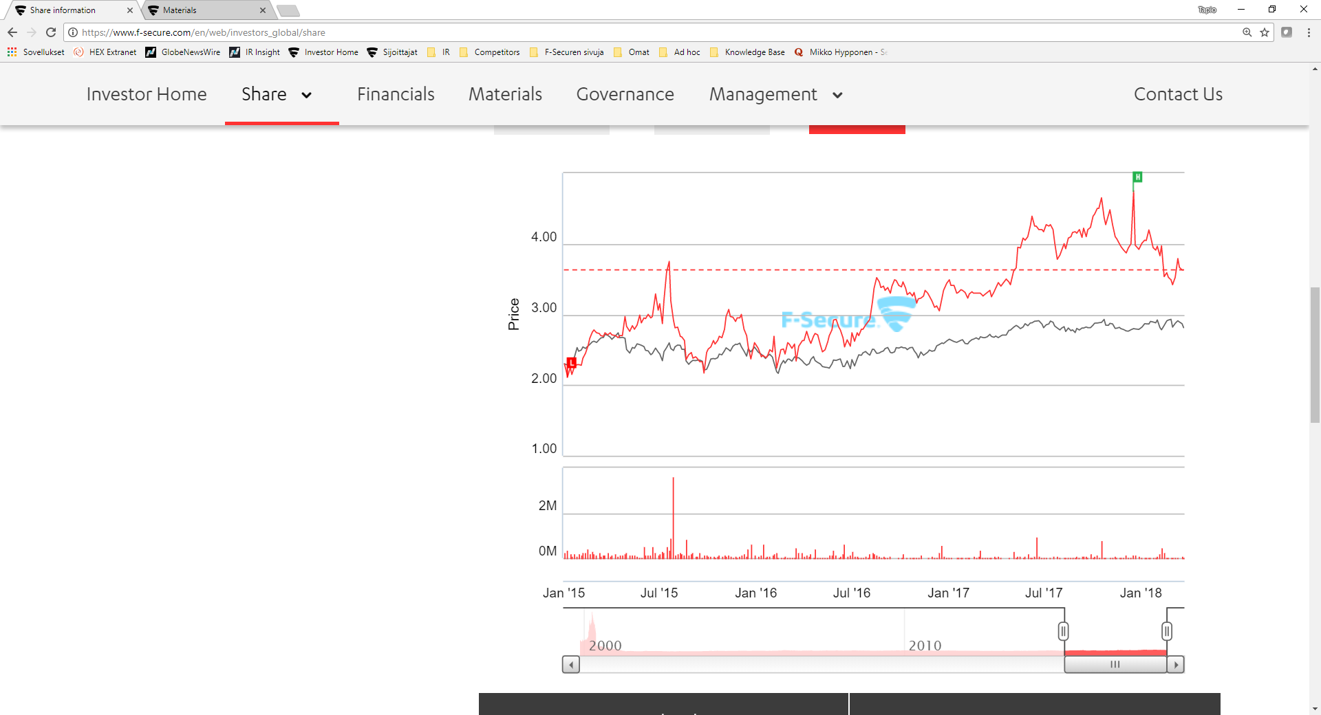
F-SECURE SHARE PRICE AFTER THE NEW STRATEGY
Rapid Detection Service launched
Q4/16
Q1/17
Q2/17
Q3/17
Q4/17
Younited sold to Synchronoss
Share price
(in Eur)
4.00
nSense
acquisition
3.00
2.00
1.00
Share price change: 1 Jan -31 Dec 2017: +11%
Volume
(in shares)
2 m
January
2015
January
2016
January
2017
January
2018
F-Secure
Nasdaq Helsinki

Slide 29
AT YOUR SIDE,
WATCHING YOUR BACK.

